Slide 1
BASIC AND ADVACED CARDIAC LIFE SUPPORT

Slide 2
OBJECTIVES
Demonstrate understanding of concepts of BLS
Perform Basic life support
Apply concepts of ACLS
Apply the systemic approach to ACLS
manage patients with cardiac arrhythmias and cardiac arrest
participate in Teamwork to manage patients with cardiopulmonary emergency

Slide 3
General concepts of BLS
Importance of BLS
Gain skills on high quality CPR for all ages
Gain skills on single rescuer and multiple rescuer
Recognize cardiac arrest
Activate the emergency response early
Respond quickly and confidentially to emergencies

Slide 4
Epidemiology of cardiac arrest
Sudden cardiac arrest remains the leading cause of death in the USA
Nearly 360000 OHCA occur annually
35% of cardiac arrest are unwitnessed
Outcome remain poor
10% of adults with non-traumatic arrests treated with EMS survive to hospital discharge

Slide 5
BLS age definition
Adults – adolescents and older
Children- 1year of age to puberty
Infants – < 1 year of age
Notes:
Adolescents –after onset of puberty which is characterized by chest or underarm hair in males and breast development in females.
Infants –exclude newly born in the delivery room

Slide 6
General concepts
High-quality CPR
Approach to resuscitation attempt
Personal protective equipment
Chain of survival
Emergency response system
Building blocks of CPR

Slide 7
1. High quality CPR
Life-saving procedure for a victim who has signs of cardiac arrest (unresponsive, no normal breathing, and no pulse)
CPR- involves chest compression and rescue breaths
It improves victim’s survival
Start compression within 10 seconds of cardiac arrest recognition
Push hard and fast at a rate of 100 to 120/min
Depth –
2inches ( 5cm) in adults
One-third the depth of the chest 2inches(5cm) in children
One-third of the chest 1.5 inches (4cm) in infants

Slide 8
ct
Allow complete chest recoil
Minimize interruption of compression to < 10sec
Give effective breaths that makes the chest to rise
Avoid excessive ventilation
N.B – Compression are normally shallow than deep however research suggest compression > 2.4( 6cm) in adults cause injuries
The use of CPR feedback devices will make you set an optimal compression depth of 2-2.4inches ( 5-6cm)

Slide 9
2. Approach to resuscitation attempts
Every situation is unique and the response will be determined by;
Available emergency equipment
Availability of trained rescuer
Level of training expertise
Local protocols

Slide 10
3. Personal protective equipment
They are worn to protect the rescuer from health /safety risks
They vary depending on the situation and protocols
They include
Medical gloves
Eye protection
High visibility clothing
Fully body coverage
Safety footwear
Safety helmets

Slide 11
4. Chain of survival
Dfn – chain of events that must occur in rapid succession to maximize the chances of survival from sudden cardiac arrest(SCA)
AHA adopted , helped and supported in developing the concepts of emergency cardiovascular care
The COS provides a useful metaphor for the element of the ECC systems of care concept
SCA can occur anywhere- streets, at home ,ED, ICU, patients bed etc.
Care is dependent on where SCA has occurred(in or out of hospital)

Slide 12
Chain of survival for IHCA
Arrest occur due to worsened respiratory or circulatory condition
SCA are predictable and preventable through careful observation, prevention and early treatment of pre arrest conditions
Resuscitation teams are activated immediately the patient arrest
Early HQCPR, defibrillation are essential
Survival depends on the smooth running of the institution various departments and team of professionals

Slide 13
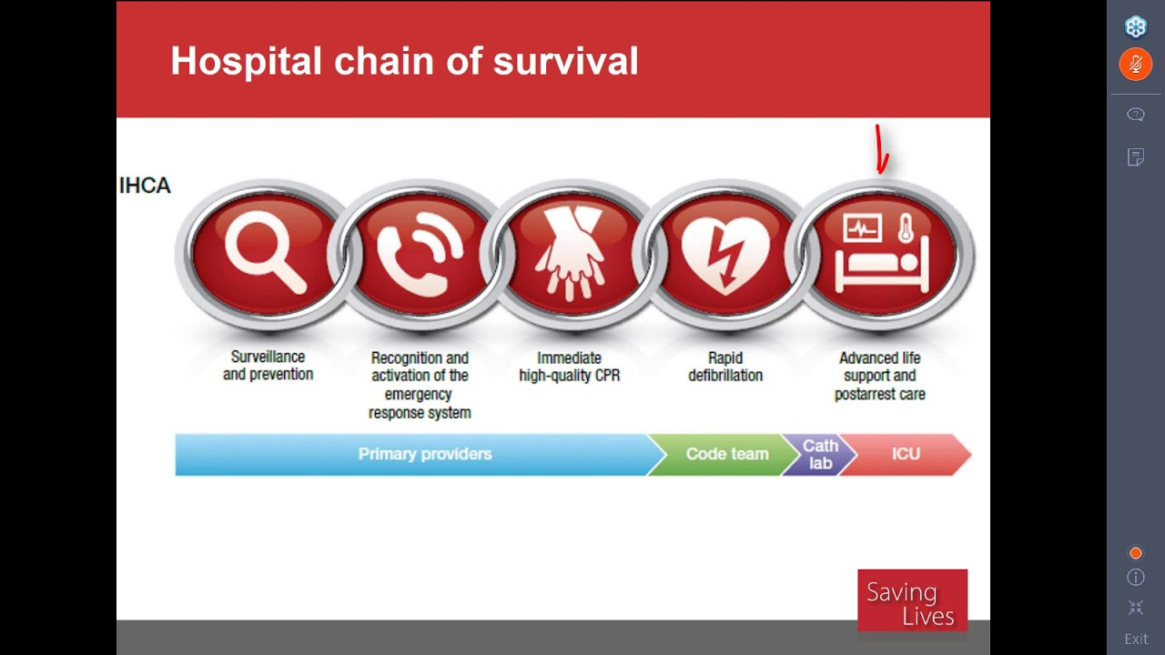
Adult link for IHCA chain of survival
Surveillance, prevention, and treatment of pre-arrest conditions
Immediate recognition of cardiac arrest and activation of the emergency response system
Early CPR with emphasis on chest compression
Rapid defibrillation
Multidisciplinary post-cardiac arrest care

Slide 14
Adult OHCA chain of survival
Sudden cardiac arrest occurs unexpectedly and results from an underlying cardiac problem
A successful outcome depends on
Early bystander CPR
Rapid defibrillation in the first few minutes
A lay rescuer is expected to recognize the victim’s distress, call for help, and start CPR, initiate public access defibrillation until EMS arrives
EMS takes over efforts – ALS, transport to ED or Cath lab

Slide 15
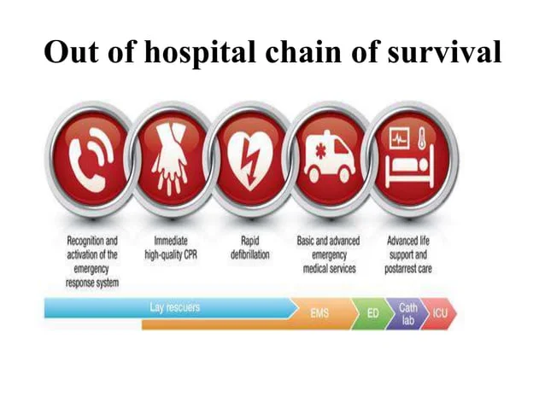
Adult links of the out-of-hospital chain of survival
Immediate recognition of cardiac arrest and activation of the emergency response system
Early CPR with emphasis on chest compression
Rapid defibrillation with AED
Effective ALS, transport to post-arrest care
Multidisciplinary post-cardiac arrest care

Slide 16
Key differences between IHCA and OHCA
ELEMENT | IHCA | OHCA
Initial support | Depends on in hospital system of appropriate surveillance, monitoring and prevention with responsive primary provider team | Depends on community and EMS providers for support
Resuscitation team | Depends on smooth interactions of various departments | Lay rescuers for recognition and EMS ALS and transport to ED/ICU
Available resources | In a hospital multidisciplinary team which may have access to more personnel as well as resources of the ED ,Cath lab and ICU | Lay rescuers may have access to AED, Emergency /first aid equipment and dispatch team and paramedics
Resuscitation constraints | Both may be affected by factors such as crowd control, family presence, space constraints, resources, training, transportation and device failures
Level of complexity | They are both complex as they require teamwork and coordination among responders and care providers
Notes:
Notice that the links in the COS are not separate, but connected . Each link describes an action during a resuscitation attempt that is critical to a successful outcome. If one link is broken, the chance for a good outcome is decreased. These mutually dependent links represent the most important action in the management of cardiac arrest.

Slide 17
Importance of each link in the COS
LINK | DESCRIPTION
IN HOSPITAL CARDIAC ARREST
Surveillance, prevention and treatment of pre -arrest condition | Many arrest can be predicted and prevented by carefully observation and early treatment
Immediate recognition of cardiac arrest and activation of emergency response system | The sooner you activate the ERS the sooner the next level of care will arrive
Early CPR with emphasis on chest compression | Start CPR without delay, Improves victims chances of survival Bystanders are encouraged to perform CPR
Rapid defibrillation | Rapid defibrillation can double or triple chances of survival if combined with HQCPR Use AED- can shock to terminate abnormal rhythm Safe and simple to use by both HCW/LR
Multidisciplinary post cardiac arrest care | Advanced team of health care providers Focuses on preventing the return of cardiac arrest and tailor specific therapies to improve long term survival

Slide 18
OHCA
Immediate recognition of cardiac arrest and activation of emergency response system | Recognize and activation of ERS
Early CPR with emphasis on chest compression | SIMILAR TO IHCA
Rapid defibrillation with AED | SIMILAR TO IHCA
Effective advanced life support ( including rapid stabilization and transport to post cardiac arrest care | ALS bridges the transition from BLS to more advanced care ALS can occur in any setting ALS teams may provide additional care if need such as 12-lead ECG Electrical therapy interventions (cardioversion) Obtaining vascular access Giving appropriate drugs Placing an advanced airway
Multidisciplinary post cardiac arrest care | SIMILAR IHCA

Slide 19

Pediatric chain of survival
Adults’ cardiac arrest is often sudden and results from a cardiac cause.
In children is often secondary to respiratory failure and shock.
Identifying these problems reduces the likelihood of pediatric arrest.
Link include
Prevention of arrest
Early high-quality bystander CPR
Rapid activation of ERS
Effective ALS
Integrated post-cardiac arrest care

Slide 20
Cardiac arrest vs Heart attack
CARDIAC ARREST
HEAR ATTACK
The heart develops an abnormal rhythm and can’t pump blood
The abnormal rhythm causes the heart to quiver so that it can no longer pump blood to the brain, lungs, and other organs
Sudden cardiac arrest is often a rhythm problem
Blood flow to the heart muscles is blocked
Blockage occurs in the blood vessels carrying oxygenated blood to the heart muscles .
If not reopened the muscles supplied by the blocked vessel die
Heart attack is a clot problem

Slide 21
What happens in cardiac arrest
The patient becomes unresponsive, not breathing or gasping within seconds
Death occurs within minutes if the victim does not receive immediate life-saving treatment

Slide 22
What happens in heart attack
Signs appear immediately or last for weeks or longer
They include
Severe discomfort of the chest or areas of the upper body
Shortness of breath
Cold sweats
Nausea and vomiting
Typical the heart continues to pump blood
The longer the heart attack the greater the possible damage to the heart muscles
Damaged muscles can trigger abnormal rhythm that can lead to SCA
Notes:
Symptoms of heart attack can be different in women and may experience
Pain in the jaw, arms, back or neck
Light headedness
Nausea and vommiting

Slide 23
Link between CA and HA
Most heart attacks do not lead to sudden cardiac arrest
A small percentage of people with heart attacks will develop SCA
When sudden cardiac arrest occurs, heart attack is a common cause
Other conditions may also change the heart rhythm and lead to cardiac arrest

Slide 24
Emergency response system
Activation of the ERS vary depending on the set up and local protocol
ERS examples include
Hospital ERS- activates a specific hospital code, medical emergency tea etc.
Pre- hospital ERS- activating EMS, paramedics, medic units, or ALS or call for back up
Workplace/facility ERS- call 9-1-1/ the emergency medical number or activating a specific occupational safety and health administration or work place emergency response protocol

Slide 25
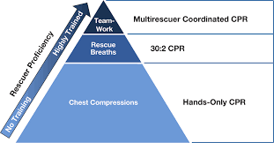
Building blocks for CPR
Hands-only CPR- single rescuer with little training and limited equipment
30:2 CPR- one provides both chest compression and breaths using the ratio of 30 chest compression to 2 breaths- e.g. a trained lifeguard
Teamwork- high performance from emergency responders. At this level compression, defibrillation and rescue breathes are handled by different people. With team approach several lifesaving interventions are performed simultaneously

